Slide 1
LECTURE: 3
ARTIFICIAL INTELLIGENCE ESSENTIALS

Slide 2
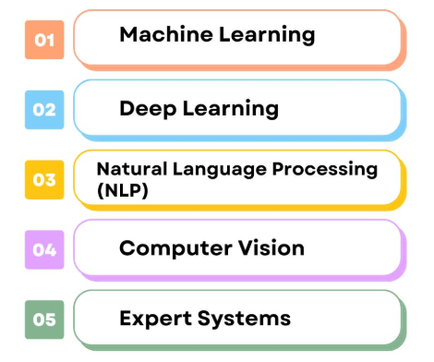
Artificial Intelligence Techniques:

Slide 3
What is Machine Learning?
Enables machines to learn from data.
Improves performance without explicit programming.
Based on algorithms and statistical models.
Focuses on pattern recognition and predictions.
Used in diverse fields like healthcare, finance.

Slide 4
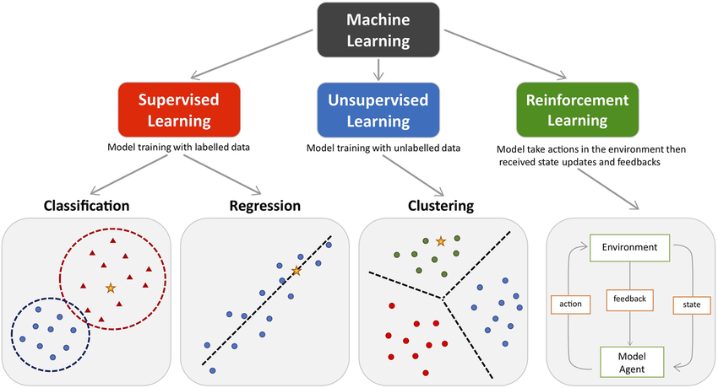
Types of Machine Learning:
Semi-Supervised Learning
Model trained with labelled and unlabelled data

Slide 5
What is Deep Learning?
Subset of Machine Learning (ML).
Uses multi-layered neural networks.
Excels in modeling complex data patterns.
Handles large datasets for high accuracy.
Applications: vision, NLP, speech recognition.

Slide 6
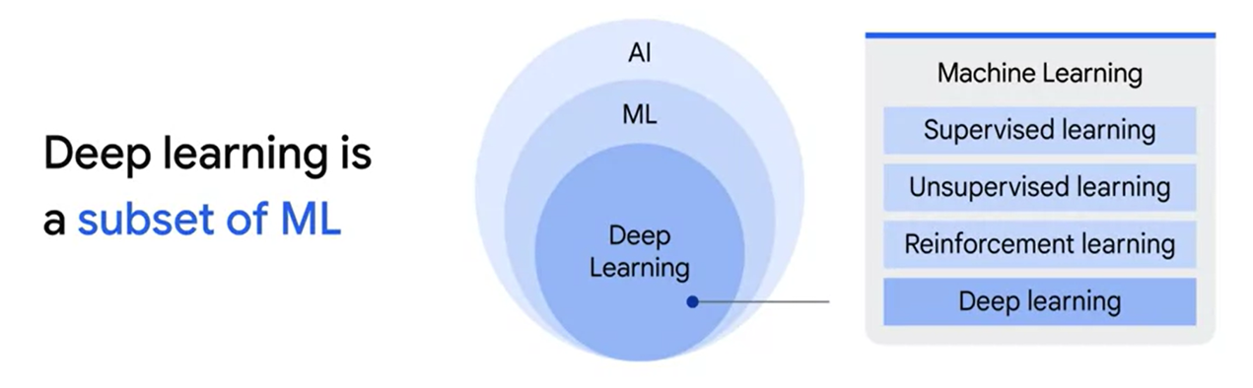

Slide 7
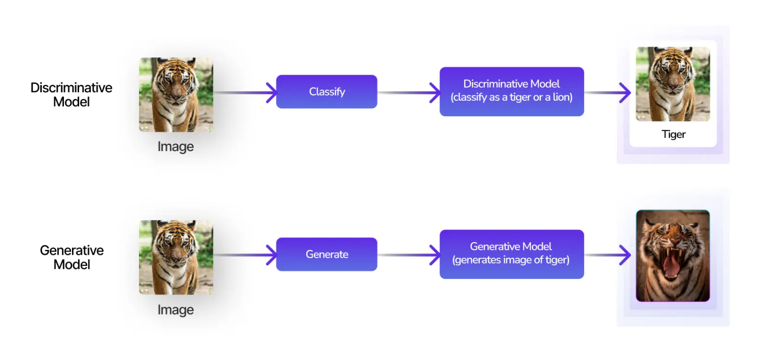
Types of Deep Learning Model:

Slide 8
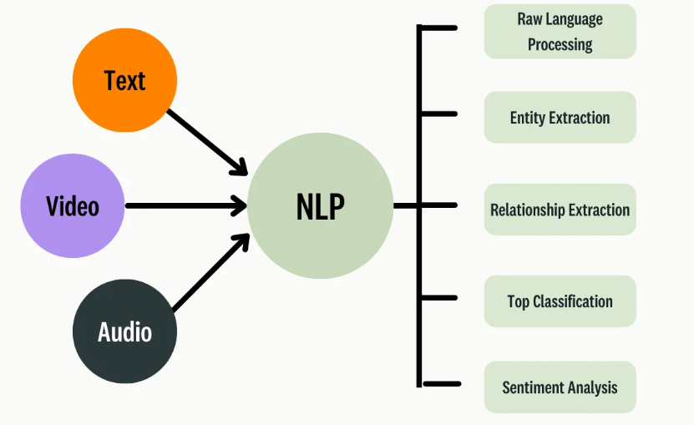
What is Natural Language Processing (NLP)?
AI for understanding human language.
Includes text and speech analysis/generation.
Handles tasks like translation, summarization.
Uses models like BERT, GPT for NLP.
Applications: chatbots, sentiment analysis, search.
Bridges communication between humans and machines.

Slide 9
What is Computer Vision?
AI for interpreting visual data.
Processes images, videos, and real-world visuals.
Tasks include object detection, image classification.
Powers facial recognition and scene understanding.
Applications: self-driving cars, healthcare imaging.
Bridges visual perception with machine understanding.

Slide 10
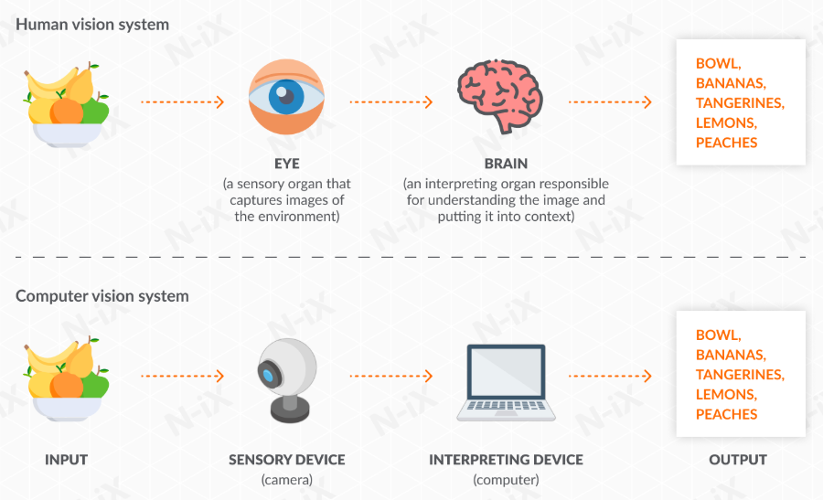
Human Vision vs Computer Vision:

Slide 11
What is Expert Systems?
AI that mimics human expertise.
Uses a knowledge base and inference engine.
Solves specific domain-related problems efficiently.
Applies if-then rules for decision-making.
Common in fields like healthcare, finance.
Provides accurate insights and problem-solving solutions.

Slide 12
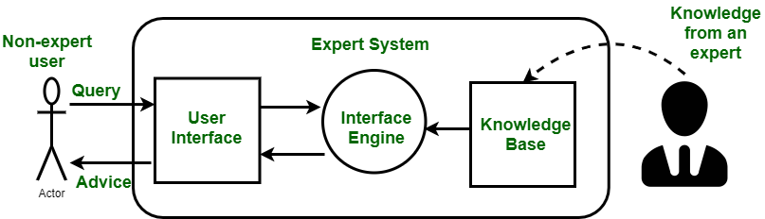
How expert system works?

Slide 13
Example of an Expert System:
Medical Diagnosis System (e.g., MYCIN).
Assists doctors by suggesting diagnoses.
Analyzes symptoms, medical history, and lab data.
Provides treatment recommendations based on expert knowledge.

Slide 14
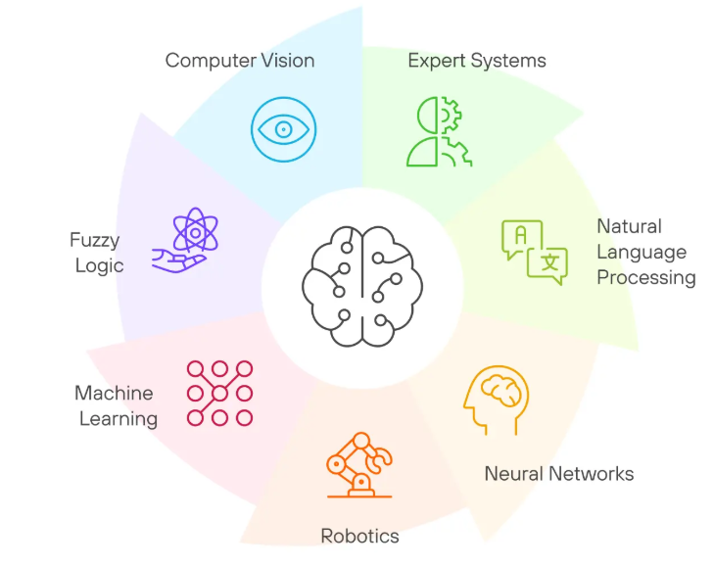
Branches of AI:
Deep Learning

Slide 15

NEXT: How does AI outsmart problems effortlessly?
Unraveling its magic in next lectures.

